Slide 1
Polyglot Flow
Embracing Diversity in Message-Oriented-Middleware

Slide 2
Who are you?
Software Developer for more than 25 years
Stuff I care about: Messaging, EDA, Microservices, TDD, XP, OO, RDD & DDD, Code that Fits in My Head, C#
Places I have worked: DTI, Reuters, Sungard, Beazley, Huddle, Just Eat Takeaway
No smart folks
Just the folks in this room

Slide 3
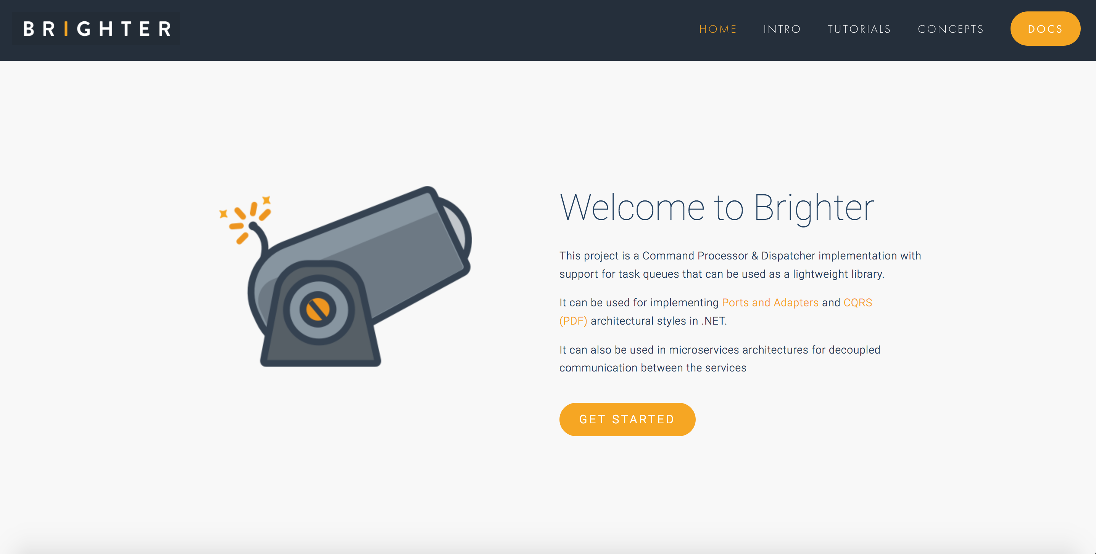

Slide 4
Agenda
Introduction: On Being Polyglot
Protocols: Queues vs Streams
Functionality: A Language is a Map of the World
Ecosystem: Beyond Routing
Environment: What is Available?
Choice: Making Decisions

Slide 5
Progress
T: 3
Introduction: On Being Polyglot
Protocols: Queues vs Streams
Functionality: A Language is a Map of the World
Ecosystem: Beyond Routing
Environment: What is Available?
Choice: Making Decisions

Slide 6
Polyglot Programming
Neal Ford, 2006
“I'm beginning to see a time where even the core language (the one that gets translated to byte code) will cease its monoculture… some languages are a better fit, because their properties match, when applied to problems, than others. “
Polyglot Persistence
Martin Fowler, 2011
“If you integrate through HTTP it no longer matters how an application stores its own data, which in turn means an application can choose a data model that makes sense for its own needs. ”
Polyglot Flow
“Understanding the properties of the protocols used by middleware reveals that those protocols provide middleware with different trade-offs. This means that some middleware is a better fit for some use cases than others.”

Slide 7
Polyglot Programming
Tim Bray, 2014
“There is a re­al cost to this con­tin­u­ous widen­ing of the base of knowl­edge a de­vel­op­er has to have to re­main rel­e­van­t.”
Polyglot Persistence
Martin Fowler, 2011
“This will come at a cost in complexity… data storage is usually a performance bottleneck, so you have to understand a lot about how the technology works to get decent speed.”
Polyglot Flow
It’s an increase in complexity to use more than one piece of middleware. It requires more skillsets from developers, operations, the whole chain of engineering.

Slide 8
Progress
T: 5
Introduction: On Being Polyglot
Protocols: Queues vs Streams
Functionality: A Language is a Map of the World
Ecosystem: Beyond Routing
Environment: What is Available?
Choice: Making Decisions

Slide 9
Messaging and Eventing

Slide 10
Message Types
Eventing
Messaging
Has Intent
Provides Facts
Request An Answer (Query)
Transfer of Control
(Command)
Transfer of Value
Things you Report On
No Expectations
Part of a Workflow
Part of a Conversation
History
Context
Concerned with the Future
Concerned with the Past
After Clemens Vasters https://youtu.be/ITrlLErsqzY

Slide 11
Message Types
Eventing
Messaging
Command
Event (Notification)
Document
See Gregor Hohpe: https://www.enterpriseintegrationpatterns.com/patterns/messaging/Message.html

Slide 12
Event Types
Series
Discrete
PUSH
PULL
Context
Offset
Stateless
Handler
Stateful
Partition
Processor
Discrete
Continuous
Independent
Sequential
Immediately Actionable
Report Condition
After Clemens Vasters: https://skillsmatter.com/skillscasts/10191-keynote-events-data-points-jobs-and-commands-the-rise-of-messaging

Slide 13
Queues and Streams

Slide 14
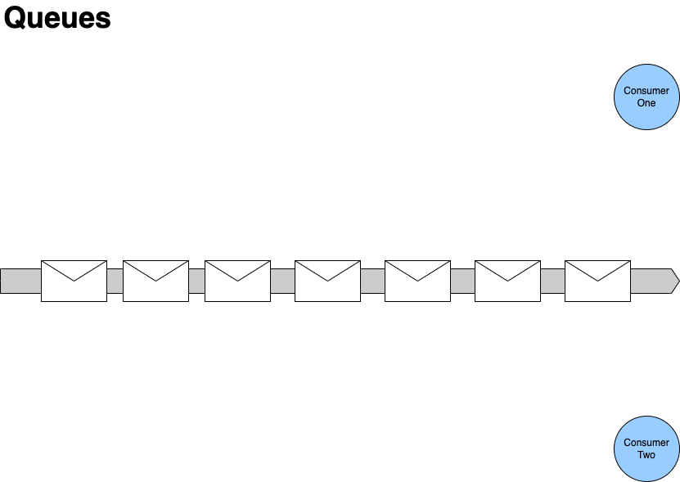

First consumer locks the next message in the queue whilst it processes it.
Second consumer reads past any locked message in the queue.
Second consumer locks the next available message in the queue.

Slide 15
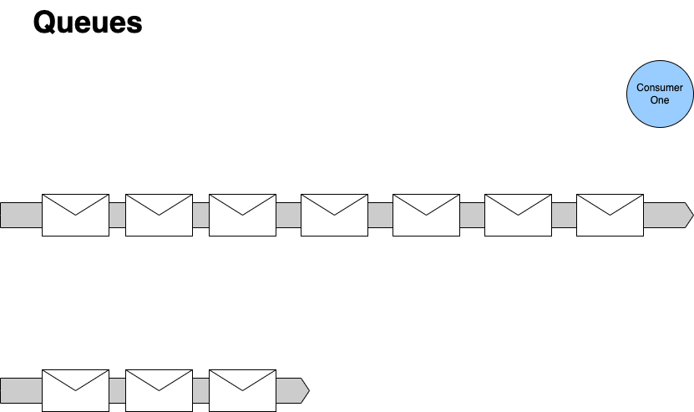



If we fail, then we may decide others could succeed later, so we let it become available to lock again, often with a delay.
When we are done processing, we unlock it.
- Usually because we finish processing it
- May be because we fail.
After a certain number of re-queues we may move the message to a dead-letter channel, it turns out that no one action the request within in a reasonable time frame
If we succeed, then we delete the message from the queue, no one else can now process it.
Queues contain Tasks
With queues we can think of the messages on a queue as tasks - they are a request for us to carry out an action. Once the action is done, we can delete the task.
- We don't anyone else to action it, it's already been done.
- Someone receiving a done task will have to discard it.
- If we can't action it, someone else will need to action it.

Slide 16
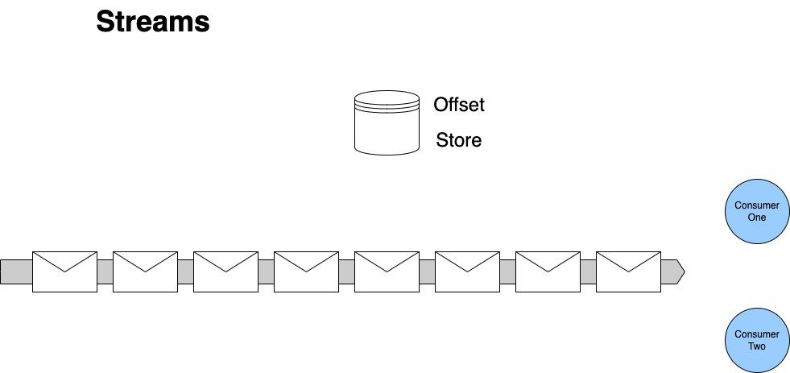
First consumer stores an offset to mark how far it has read
First consumer reads the next message in the queue and processes it.
First consumer reads the next message in the queue and processes it.
If a consumer restarts
It reads the store to determine the last message it processed
Streams contain Facts
With streams we can think of the records on the stream as facts - they are records that indicate there has been a change in state.
We can view facts as an ‘inverse database’ they represent how current stat is arrived at
We can navigate offsets to calculate a position at a ‘point in time’
We don’t consume facts by reading them, they persist
Second consumer stores an offset to mark how far it has read
Second consumer reads the next message in the queue and processes it.

Slide 17
Scaling Queues and Streams

Slide 18
First consumer locks the next message in the queue whilst it processes it.
Second consumer reads past any locked message in the queue.
Second consumer locks the next available message in the queue.

Slide 19
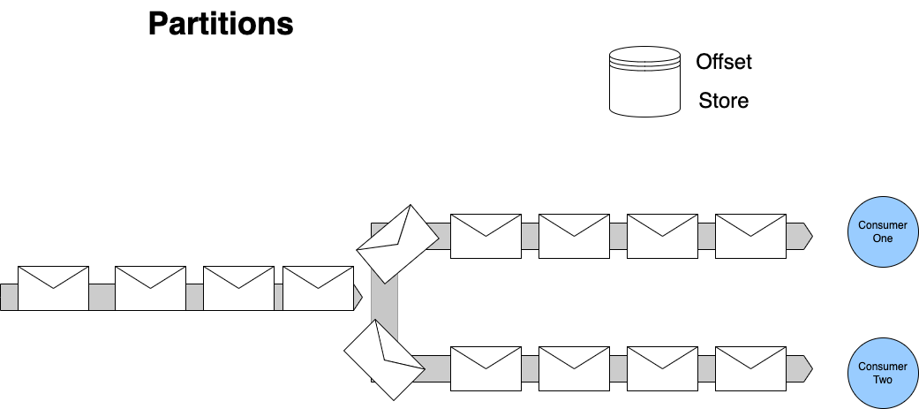
Each consumer manages offsets for their partition.
To scale out we must divide the stream up. We partition the stream to allow multiple consumers to read it.
For any set of events that must be processed sequentially - all changes to one entity for example - we use consistent hashing to push messages with the same identifier to the same partition. This allows us to scale, whilst preserving our ordering.

Slide 20
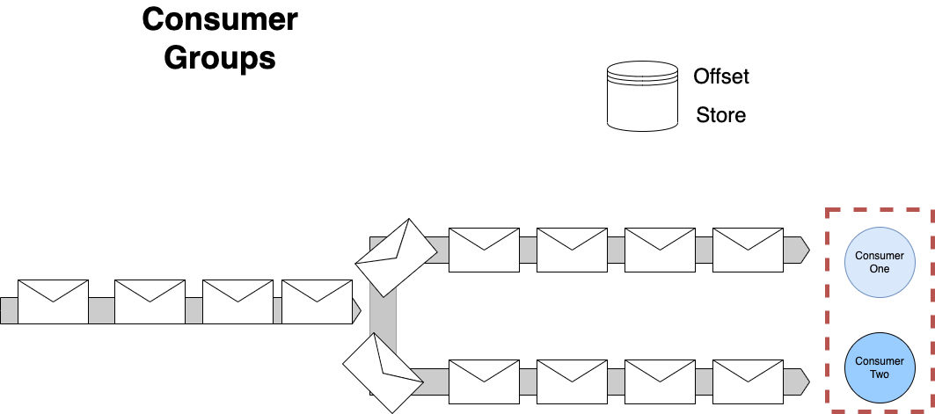
To provide availability – only one consumer in a group can read from a partition at a time – but a consumer in a group may read from more than one of the partitions owned by that group

Slide 21
Progress
T: 20
Introduction: On Being Polyglot
Protocols: Queues vs Streams
Functionality: A Language is a Map of the World
Ecosystem: Beyond Routing
Environment: What is Available?
Choice: Making Decisions

Slide 22
Commands and Events

Slide 23
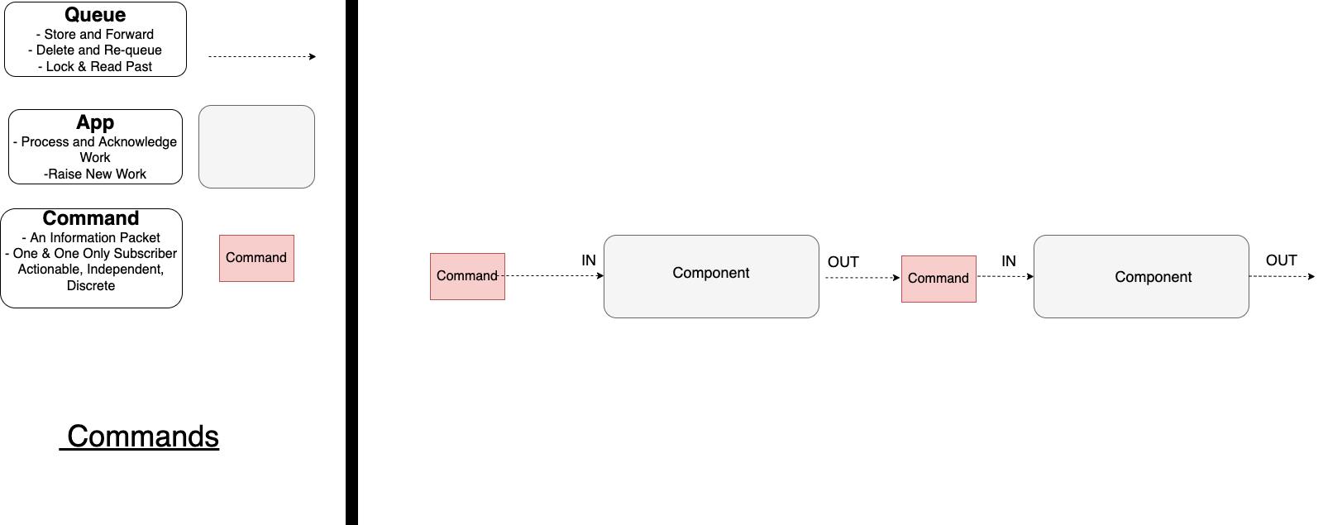
A Command is an Imperative. An instruction to another party to do something.
It is usually issued as part of a workflow.
A useful question is: is there another service I expect to handle this request?
If so you have a Command.
A Command is Discrete.
We use a Queue for a Command
A Command may be fire-and-forget or request-reply

Slide 24
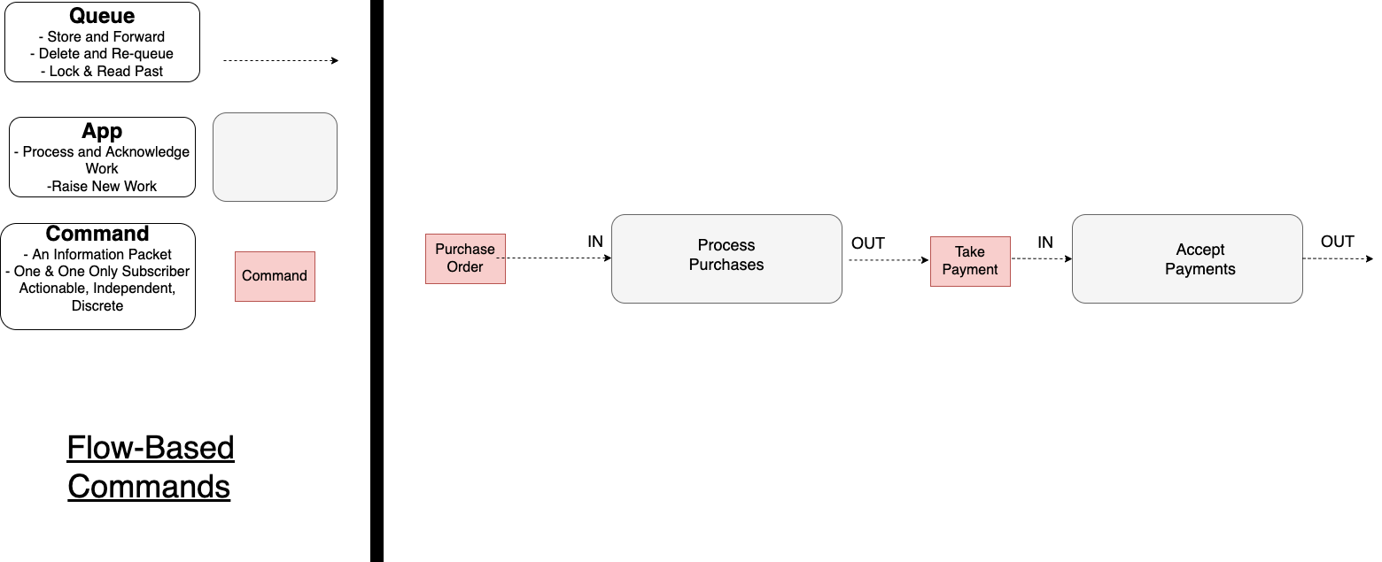
I expect that Accept Payments will take the customer’s payment for this order.
This is a Command.
I expect that Accept Payments will reply to my request.
What does this?

Slide 25
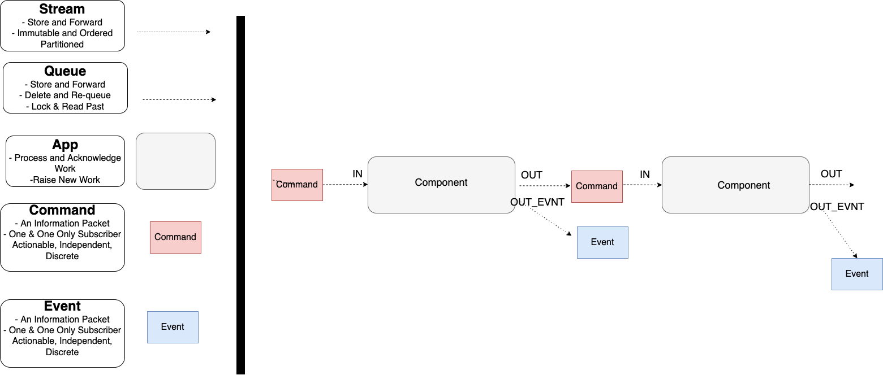
An Event may be Series or Discrete.
We can use a Stream or Queue for an Event
An Event may be the Reply in a Request-Reply. By using a correlation id, the sender can asynchronously receive a reply to their request.
An Event is a Fact that tells us something happened.
It is often issued because we have serviced a Command.

Slide 26
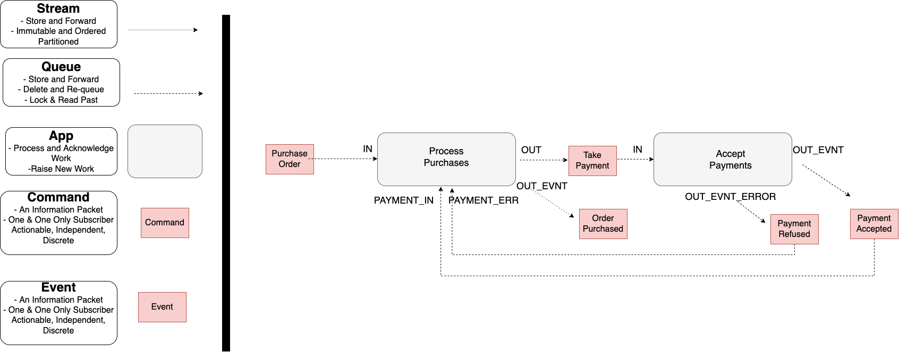
An error is just an event as a reply that indicates failure.
Accept Payments is a branch in the flow, so it does not raise a command, just an event as a reply.
A Status Update is often Series.
If it has zero or more subscribers we may prefer series – over a Stream
A Reply could be Series or Discrete.
If it is a reply to just one sender we may prefer Discrete – over a Queue

Slide 27
Archive and Replay

Slide 28
Transitive Dependencies
Purchase Order Message
OrderId | Customer First Name | Customer Last Name | Customer Post Code | Restaurant Name | Restaurant Post Code | Order Amount | Order items
12345 | Jo | Doe | SW17 3NJ | Pizza ‘R Us | SW17 5HK | 1038p | …
The lifetime of this data is not the same as the lifetime of the order
This data has a dependency on Customer.
It is a transitive dependency for Order.
If Customer changes, we maybe forced to update an Order message.
This data has a dependency on Restaurant.
It is a transitive dependency for Order.
If Restaurant changes, we maybe forced to update an Order message.
The data items here do not originate in this workflow – Customer Orders – they belong to other workflows – Customer Signup and Restaurant Onboarding.

Slide 29
Normalized
Purchase Order Message
Customer Upserted Message
OrderId | Order Amount | Order items | CustomerId | RestaurantId
12345 | 1038p | …
Customer First Name | Customer Last Name | Customer Post Code
Jo | Doe | SW17 3NJ
What we need to do to use the Purchase Order Message is to “join” it with the Customer and Restaurant data.
Restaurant Onboarded Message
We normalize the message contents.
We have an Id for data from other workflows/services
Restaurant Name | Restaurant Post Code
Pizza ‘R Us | SW17 5HK
The Customer workflow gives us Customer messages
Just like a database we can sometimes inline – denormalize – for performance, but this should be an exception, not the rule
This Restaurant workflow gives us Restaurant messages

Slide 30
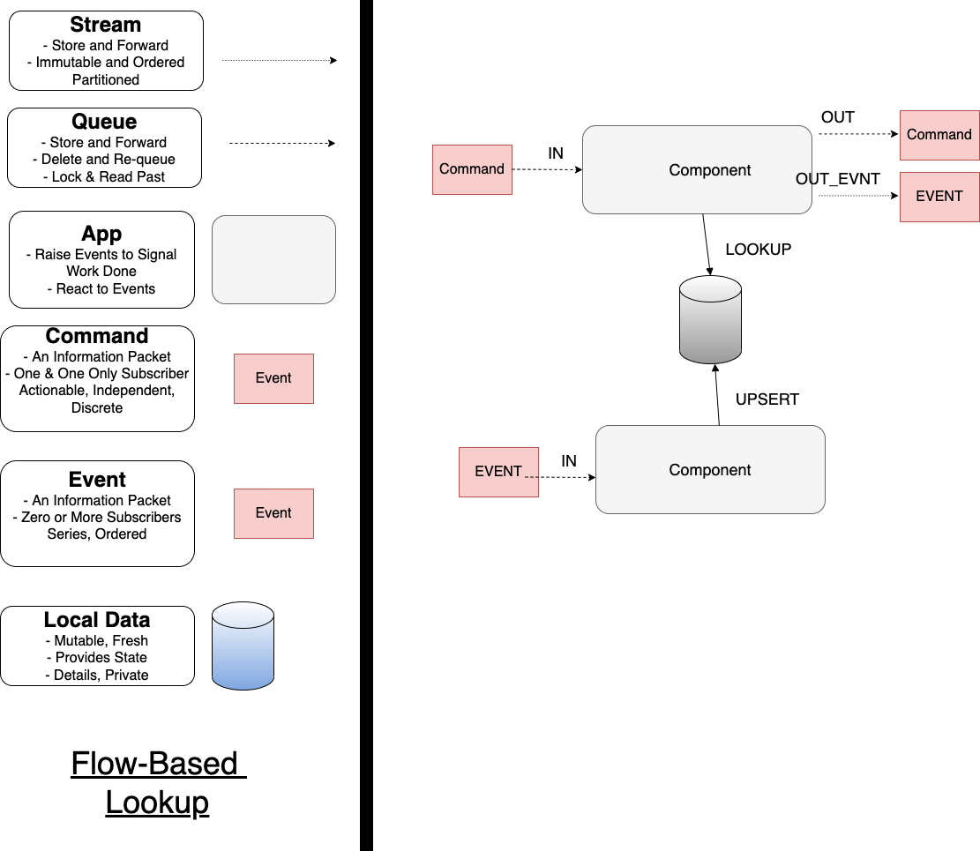
This removes the need for us to do a GET/send a request to the owner of the data to ”join” across a distributed system.
When we need to “join” this to resolve a reference we can look it up
We insert this into a lookup
Typically this is Series data so we should listen on a Stream
We listen for events that provide data we later need ”join” with work requests

Slide 31
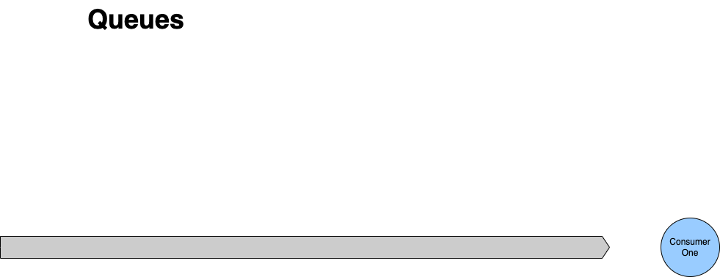

If we succeed, then we delete the message from the queue, no one else can now process it.
No Archive and Replay
With queues we delete a message once we have completed the associated action. That means we have no way to replay the request for work. Our only option is to ask the producer to resend their request.

Slide 32
We don’t delete a message, we just increment the offset.
Archive and Replay
Archive and Replay is straightforward as nothing is deleted. We simply reset the consumer’s offset to re-read the stream

Slide 33

Unless it is a private reply we tend to default to a stream for an event because it gives us flexibility about its usage as operand data.
Typically operand data is Series data so we should use a Stream to publish it.
Archive and Replay means:
We can rebuild a cache on demand
We can add new consumers of existing operand data and “catch up” with the past.

Slide 34
Requeue and Delay

Slide 35
If we fail, then we may decide others could succeed later, so we let it become available to lock again, often with a delay.
When we are done processing, we unlock it.
- Usually because we finish processing it
- May be because we fail.
After a certain number of re-queues we may move the message to a dead-letter channel, it turns out that no one action the request within in a reasonable time frame
If we succeed, then we delete the message from the queue, no one else can now process it.
Requeue and Delay
A queue supports re-queue (with delay)
If the work is not done/acked, just make it available again to the next consumer
If the work could not be done because of a transient issue, delay to let is pass

Slide 36
We don’t delete a message, we just increment the offset.
No Requeue or DLQ
Because we do not lock items, we do not requeue items, including requeue with delay. Your strategy is:
Ignore and Continue
Retry
Copy to another stream (a delay or DLQ stream)

Slide 37


 | Messaging | Discrete Event | Series Event
Queue
Stream
 | Ordering | Archive and Replay | Requeue with Delay
Queue
Stream

Slide 38
Progress
T: 30
Introduction: On Being Polyglot
Protocols: Queues vs Streams
Functionality: A Language is a Map of the World
Ecosystem: Beyond Routing
Environment: What is Available?
Choice: Making Decisions

Slide 39
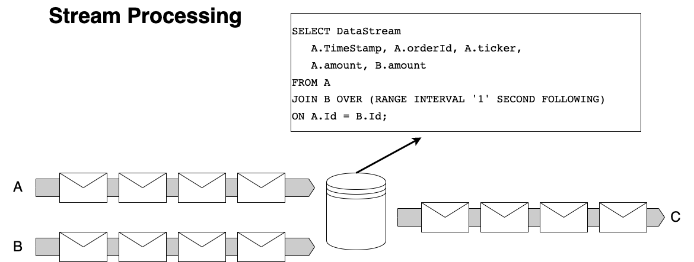
Stream Processing answers the question: how do I join data now it lives in independently deployable microservices. The answer is by exposing the facts it generates in a stream and using a steam processor
So I can write SQL across topics – provided I tell the stream processor the ‘window’ to materialize the view over.
The result is itself a newc topic.
A database is really just a materialized view across a stream of changes

Slide 40
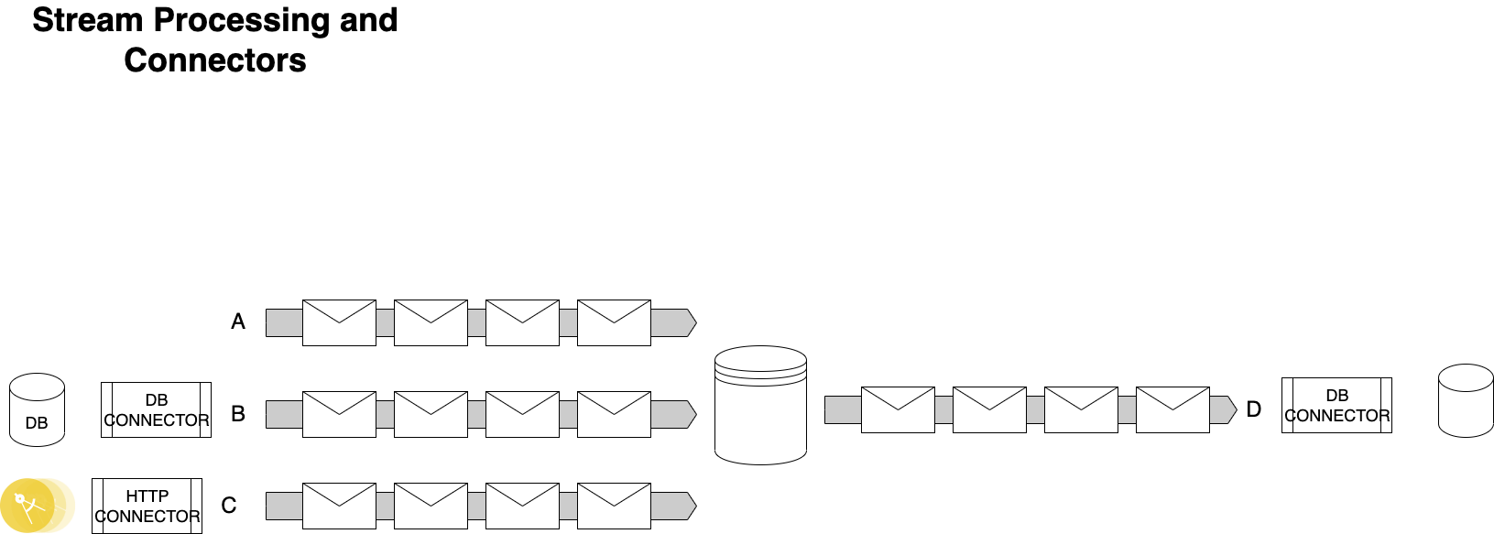
We don’t always want to keep it as a stream but turn it back into data to use it so we can also create a connector to load a database.
It’s possible that not everyone produces a stream, but tools can help us export as a stream

Slide 41
Progress
T: 35
Introduction: On Being Polyglot
Protocols: Queues vs Streams
Functionality: A Language is a Map of the World
Ecosystem: Beyond Routing
Environment: What is Available?
Choice: Making Decisions

Slide 42
Rack
Cloud
Containers
Queue
Kafka
SNS/SQS
NATS
Stream
RabbitMQ
Kinesis
Pulsar
Both
ActiveMQ
Azure Service Bus
Azure Event Hubs
Google Pub/Sub

Slide 43
Progress
T: 40
Introduction: On Being Polyglot
Protocols: Queues vs Streams
Functionality: A Language is a Map of the World
Ecosystem: Beyond Routing
Environment: What is Available?
Choice: Making Decisions

